Slide 1
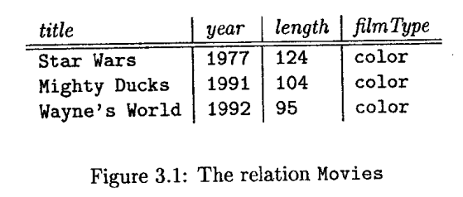
Basics of Relational Model
The relational model gives us a single way to represent data: as a two-dimensional table called a relation.
In the fig, the name of the relation is Movies, and it is intended to hold information about the entities in the entity set Movies.
Each row corresponds to one movie entity, and each column corresponds to one of the attributes of the entity set

Slide 2
Basics of Relational Model
Attributes
Across the top of a relation, we see attributes; in above Fig. 3.1 the attributes are title, year, length, and filmType. Attributes of a relation serve as names for the columns of the relation.
Schemas
The name of a relation and the set of attributes for a relation is called the schema for that relation.
We show the schema for the relation with the relation name followed by a parenthesized list of its attributes.
Thus, the schema for relation Movies of Fig. 3.1 is
Movies(title, year, length, filmType)
The set of schemas for the relations in a design is called a relational database schema, or just a database schema.

Slide 3

Basics of Relational Model
Tuples
The rows of a relation, other than the header row containing the attribute names, are called tuples. A tuple has one component for each attribute of the relation.
A tuple has one component for each attribute of the relation. For instance, the first of the three tuples in Fig. 3.1 has the four components Star Wars, 1977, 124, and color for attributes title, year, length, and filmType, respectively.
Domains
The relational model requires that each component of each tuple be atomic; that is, it must be of some elementary type such as integer or string.
It is not permitted for a value to be a record structure, set, list, array, or any other type
that can reasonably have its values broken into smaller components.

Slide 4
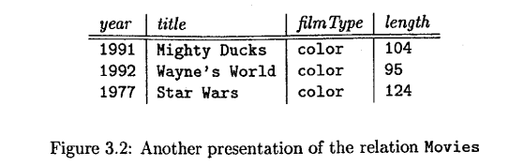
Basics of Relational Model
Equivalent Representations of a Relation
Relations are sets of tuples, not lists of tuples. Thus the order in which the tuples of a relation are presented is immaterial. For example, we can list the three tuples of Fig. 3.1 in any of their sis possible orders, and the relation is "the same" as Fig. 3.1.
Relation Instances
We shall call a set of tuples for a given relation an instance of that relation.
For example, the three tuples shown in Fig form an instance of relation
Movies.

Slide 5
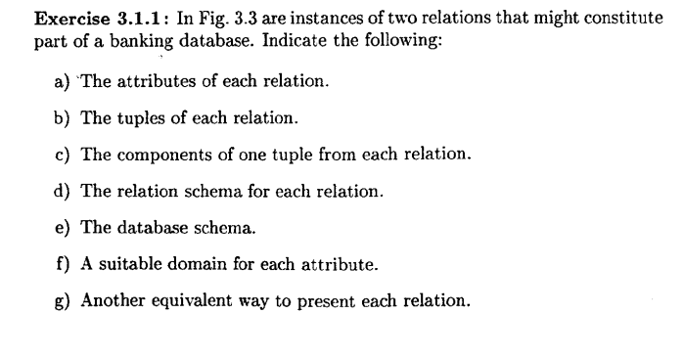
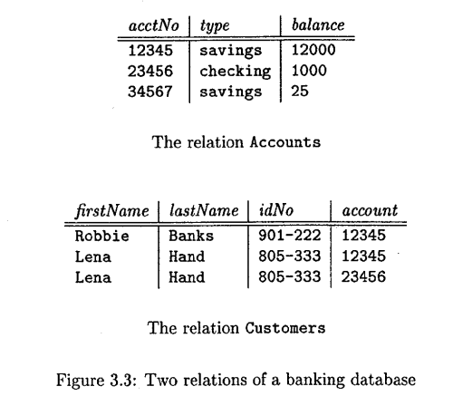
Basics of Relational Model

Slide 6
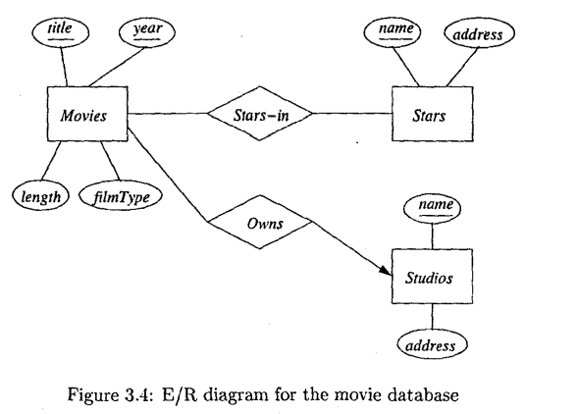
Basics of Relational Model
From E/R Diagrams to Relational Designs

Slide 7
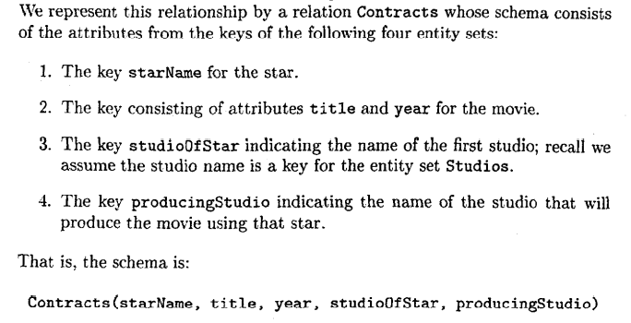
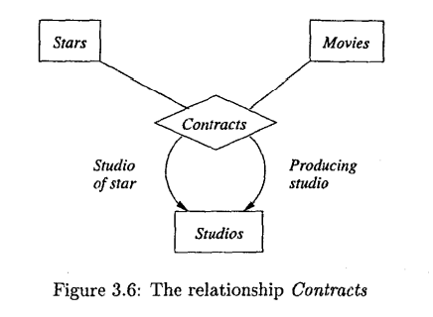
Basics of Relational Model
From E/R Diagrams to Relational Designs

Slide 8
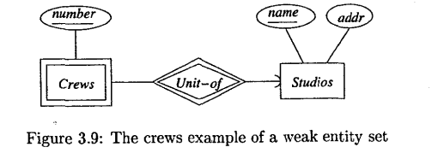
Basics of Relational Model
From E/R Diagrams to Relational Designs

Slide 9
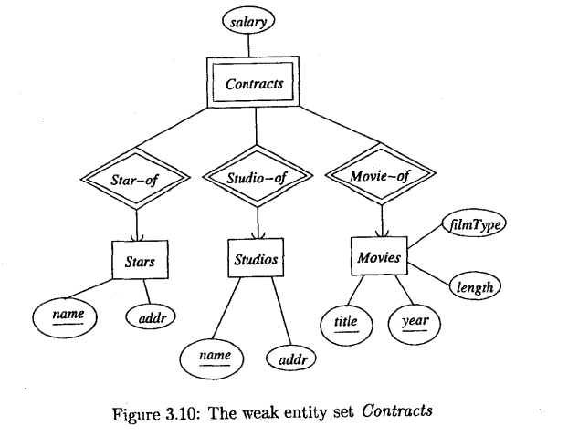
Basics of Relational Model
From E/R Diagrams to Relational Designs

